Slide 1
Technical Session IV Classification and Clustering

Slide 2
Agenda
Classification – KNN
Clustering- K-Means

Slide 3
Types of learning
Supervised - Classification
Unsupervised - Clustering
Reinforcement

Slide 4
Supervised Vs Unsupervised
Supervised learning (classification)
Supervision: The training data (observations, measurements, etc.) are accompanied by labels indicating the class of the observations
New data is classified based on the training set
Unsupervised learning (clustering)
The class labels of training data is unknown
Given a set of measurements, observations, etc. with the aim of establishing the existence of classes or clusters in the data

Slide 5


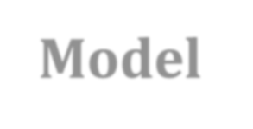
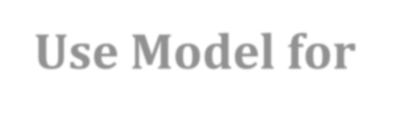

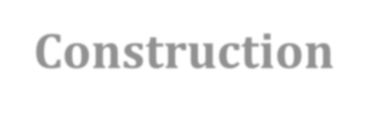
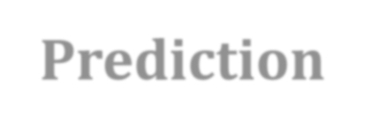
CLASSIFICATION
Predicts unknown class label
Classifies the data based on training set
Applications:
Credit Card Approval
Medical Diagnosis
Target Marketing
Fraud Detection
Model Construction
Use Model for Prediction

Slide 6
CLASSIFICATION
Given a collection of records (Training set )
Each Record contains a Set of Attributes
One of the attributes is the Class (Label)
Find a Model for Class attribute as a function of the values of other attributes.
Goal: Previously unseen records should be assigned a class as accurately as possible.
A test set is used to determine the accuracy of the model.

Slide 7
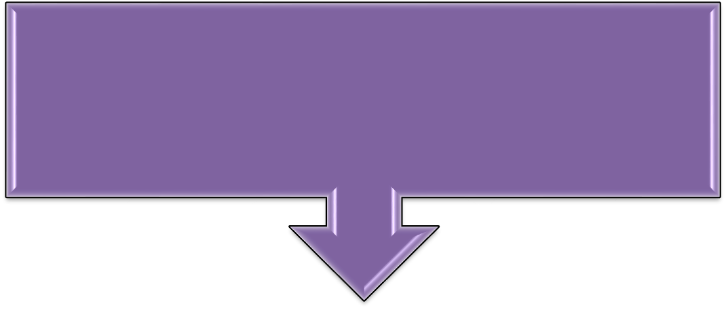



CLASSIFICATION
Usually, the given data set is divided into, Training and Test sets
Training Data set
Build the Model
Testing Data set
Validate the Model

Slide 8
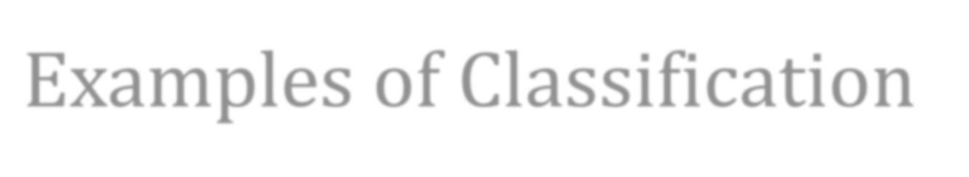
Examples of Classification
Predicting tumor cells as benign or malignant
Classifying credit card transactions as legitimate or fraudulent
Classifying secondary structures of protein as alpha- helix, beta-sheet, or random coil
Categorizing news stories as finance, weather, entertainment, sports, etc

Slide 9
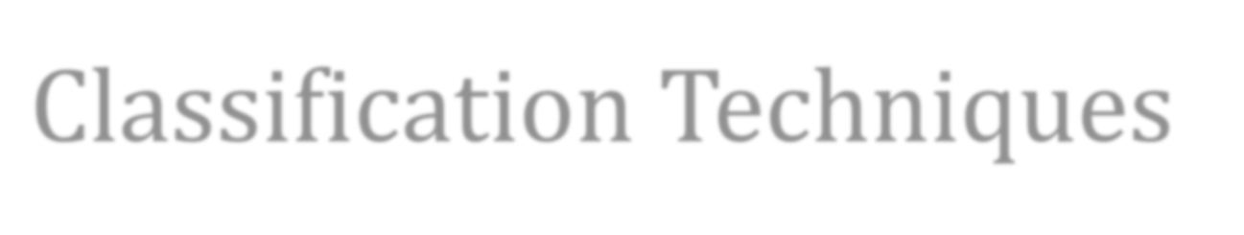
Classification Techniques
Decision Tree based Methods
Naïve Bayes and Bayesian Belief Networks
Neural Networks
Support Vector Machines
Rule-based Methods
Memory based reasoning

Slide 10
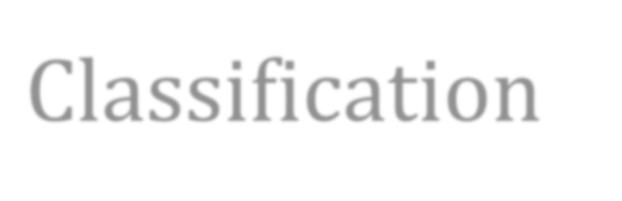
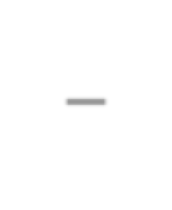
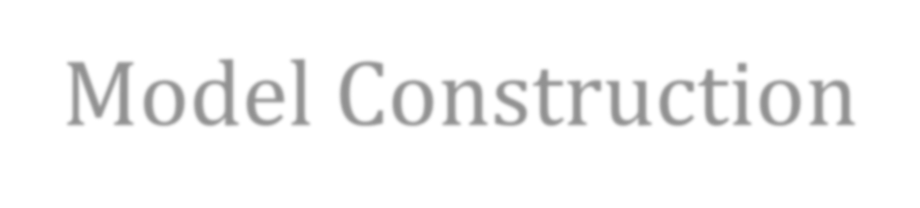
Classification – Model Construction
Classification Algorithms
Training Data
Classifier (Model)
Name | Rank | Years | Permanent
Arun | Assistant Prof | 3 | No
Vijay | Assistant Prof | 7 | Yes
Selva | Professor | 2 | Yes
Kumar | Associate Prof | 7 | Yes
Rahul | Assistant Prof | 6 | No
Raj | Associate Prof | 3 | No
IF Rank = ‘Professor’
OR Years > 6
THEN Permanent = ‘Yes’

Slide 11
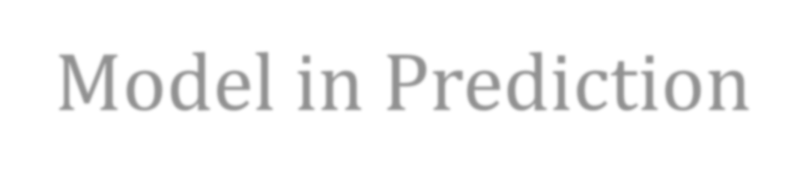

Classification – Model in Prediction
Classifier
Testing Data
Unseen Data
(Dhana, Professor, 4)
Permanent?
Name | Rank | Years | Permanent
Vignesh | Assistant Prof | 2 | No
Anand | Associate Prof | 7 | No
Kavin | Professor | 5 | Yes
Mano | Assistant Prof | 7 | Yes

Slide 12
KNN
KNN can be used for both classification and regression predictive problems.
However, it is more widely used in classification problems in the industry.

Slide 13
Steps
Load the data
Initialise the value of k
For getting the predicted class, iterate from 1 to total number of training data points
Calculate the distance between test data and each row of training data. Here we will use Euclidean distance as our distance metric since it’s the most popular method. The other metrics that can be used are Chebyshev, cosine, etc.
Sort the calculated distances in ascending order based on distance values
Get top k rows from the sorted array
Get the most frequent class of these rows
Return the predicted class

Slide 14
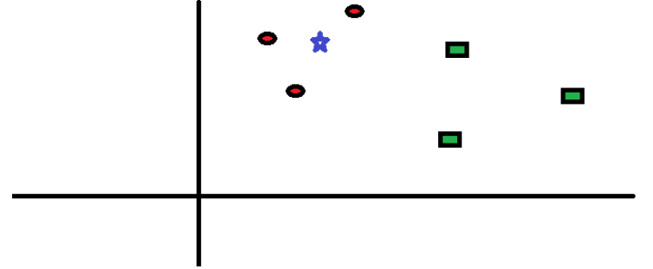
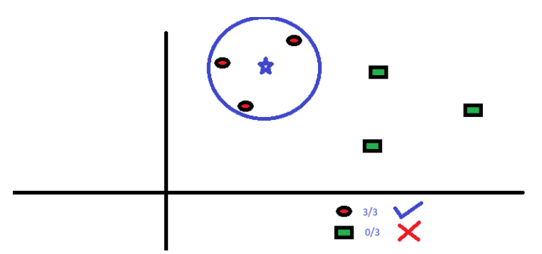
At K=3

Slide 15
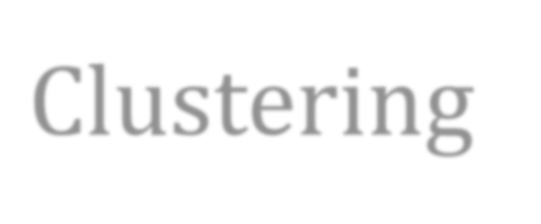
Clustering
Group the data based on similarity
Based on distance
Compute Similarity
Partition Clustering
Hierarchical Clustering
Grid Clustering
Density Based Clustering

Slide 16
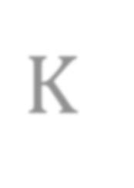

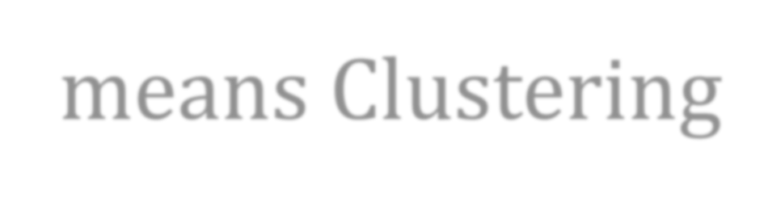
K- means Clustering
K – No. of Clusters
K can be specified as any number
Data Should be Continuous & Numeric

Slide 17
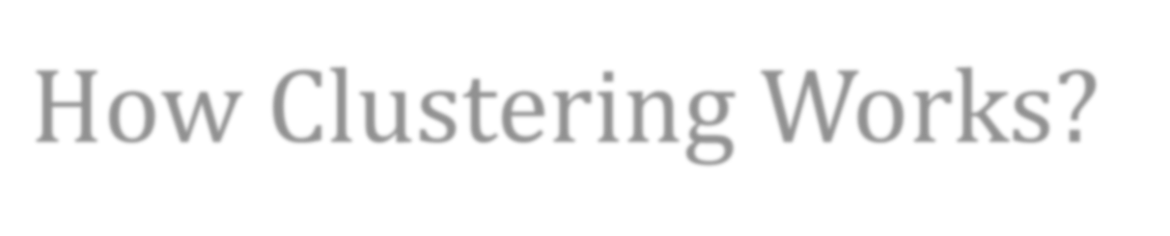


How Clustering Works?
Input Elements: Objects
– X1, X2, X3, X4
Choose no. of clusters (K) = 2
Randomly assign objects to cluster as “Centroid”
– X2, X4
X2
X1
X4
X3
Cluster 1
Cluster 2

Slide 18

How Clustering Works?
1. Compute Distance
d(X2, X1) : 0.2
d(X4, X1) : 0.4
d(X2, X3) : 0.3
d(X4, X3) : 0.25
Less distance; X1 is close to X2
Less distance; X3 is close to X4
Compute New Centroid by taking mean of the objects in the cluster.
Goto step 1; Iterate it until no movement of Objects around Cluster.

Slide 22
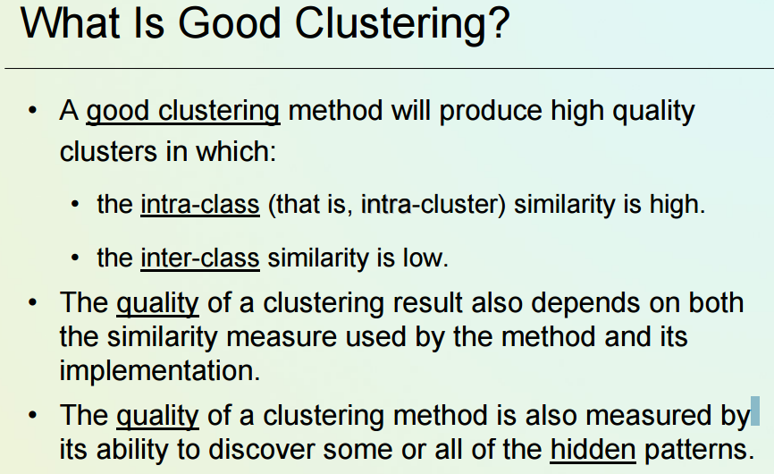

Slide 24
K-means
Given k, the k-means algorithm consists of four steps:
Select initial centroids at random.
Assign each object to the cluster with the nearest centroid.
Compute each centroid as the mean of the objects assigned to it.
Repeat previous 2 steps until no change.

Slide 25
k – means algorithm
Strengths
Relatively efficient: O(tkn), where n is # objects, k is # clusters, and t is # iterations. Normally, k, t << n.
Often terminates at a local optimum. The global optimum may be found using techniques such as simulated annealing and genetic algorithms
Weaknesses
Applicable only when mean is defined (what about categorical data?)
Need to specify k, the number of clusters, in advance
Trouble with noisy data and outliers
Not suitable to discover clusters with non-convex shapes

